Slide 1
BiblioConnect
Library Management & Literary Social Network
Jesus Aguayo, William Arata, Joshua Patrick Cainglet, Jorge Chavez, Vinny Ngo

Slide 2
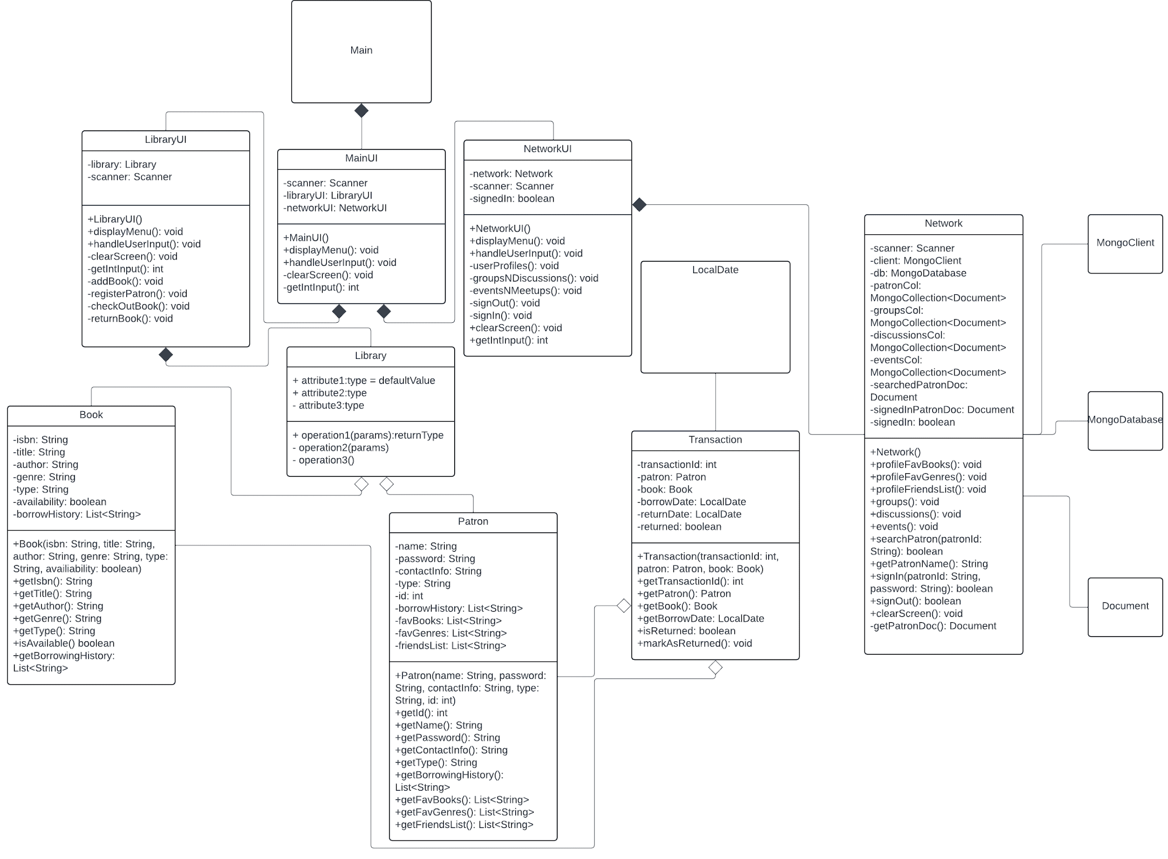
Overall System Design in UML

Slide 3
Class Diagrams
Book
-isbn : String -title : String -author : String -genre : String -type : String -availability : boolean -borrowHistory : List<String>
+getIsbn() : String +getTitle() : String +getAuthor() : String +getGenre() : String +getType() : String +isAvailable() : boolean +getBorrowHistory() : List<String>
Patron
-name : String -password : String -contactInfo : String -type : String -id : Int -borrowHistory : List<String> -favBooks : List<String> -favGenres : List<String> -friendsList : List<String>
+getId() : Int +getName() : String +getPassword() : String +getContactInfo() : String +getType : String +getBorrowingHistory() : List<String> +getFavBooks() : List<String> +getFavGenres() : List<String> +getFriendsList() : List<String>
Transaction
-transactionId : Int -patron : Patron -book : Book -borrowDate : LocalDate -returnDate : LocalDate -returned : boolean
+getTransactionId() : Int +getPatron() : Patron +getBook() : Book +getBorrowDate() : LocalDate +getReturnDate() : LocalDate +isReturned() : boolean +markAsReturned() : void
Library
+addBook(book : Book) +addPatron(patron : Patron) +borrowBook(patronId : int, isbn : String) +returnBook(id : int)
LibraryUI
+displayMenu() : void +handleUserInput : void +clearScreen() : void +getIntInput : Int +addBook() : void +registerPatron() : void +checkOutBook() : void +returnBook() : void

Slide 4
Literary Social Network Extension
Extending the Library Management System, the Literary Social Network functionality allow patrons to interact and connect. Leveraging MongoDB for database implementation, patrons can now seamlessly sign into their accounts via the command line interface, gaining access their profile, groups, events, and more than just checking out books.
Literary Social Network capabilities:
Showcase their favorite books and genres
Add an unlimited amount of friends
Create and join groups and participate in discussions
Create, view, and participate in events or meetings
Notes:
Full Title(Experience of extending your system for Assignment#2 (Library System) to cover the Literary Social Network features)

Slide 5
Use Case Diagram: Library Management System
<<extends>>
Register Patrons
<<extends>>
Student Patron
Librarians
Faculty Patron
<<uses>>
Add Books
Book Management System
Check out books
<<uses>>
Users
Transaction System
<<uses>>
Return books

Slide 6
Use Case Diagram: Literary Social Network
<<extends>>
Register Patrons
Student Patron
<<extends>>
Librarians
Faculty Patron
<<uses>>
Add Books
Book Management System
Check out books
<<uses>>
<<uses>>
Return books
Transaction System
Users
<<uses>>
User Profile
Network System
MongoDB Database
<<uses>>
Manage Events
<<uses>>
Manage Discussions

Slide 7
Examples of learned software engineering principles
Design:
In the project's design phase, early challenges emerged as functions and classes became increasingly complicated. Recognizing the need for a better design, we created a UML diagram to visualize an implementation to simplify and extend our existing codebase without extensive modifications
Implementation:
With the improved UML diagram, we followed its blueprint to enhance our existing Library system. Each class and function was separated to adhere to the principle of single responsibility, facilitating better organization and maintainability.
Testing:
Throughout the program's development, testing was conducted on both the application and its database. We compared expected outcomes with actual results, making sure the behavior of each class's functions and sub-classes to ensure it behave as intended with their parent classes.
Notes:
Full Title: Examples of how you apply what we have learned in software engineering while designing and developing for the project

Slide 8
Thank You!

